Slide 1





MOVIE
RECOMMENDATION ANALYSIS

Slide 2




tEAM MEMBERS :
Gnana Vardhan Siddu Paruvada
Bhargavi Karuku
Janani Ganji
Giri Merugu

Slide 3



Contents
Introduction
1
Business Scenario
2
Methodology
3
Results
4
Key Takeaways
5

Slide 4



Introduction
In today's digital age, businesses benefit from extensive data access, presenting both opportunities and challenges. Leveraging data for valuable insights is crucial for gaining a competitive advantage and making informed decisions. One industry where data analysis is prominent is entertainment, particularly in providing personalized movie recommendations to customers based on their preferences and behavior.
This project focuses on analyzing movie recommendation data by utilizing Microsoft Azure's cloud infrastructure and Spark SQL's analytical capabilities. The widely-used MovieLens dataset, containing user information and movie ratings, forms the basis of our analysis. By utilizing Databricks and Azure Data Factory, we establish a robust data pipeline to efficiently manage and process this dataset.

Slide 5

Business Scenario
In the dynamic entertainment sector, providing tailored movie recommendations is crucial for improving user engagement and satisfaction. This project centers on utilizing SparkSQL to conduct in-depth analysis of movie recommendations. By leveraging cutting-edge analytics and cloud infrastructure, we seek to extract valuable insights from extensive movie datasets. This analysis will enable businesses to optimize content selection, boost customer retention, and gain a competitive edge in the digital streaming industry.

Slide 6

Challenges
There are several challenges with previous recommendation analysis. Some of them are:
Outdated Technology and Tools
Limited Scalability for Big Data
Ineffective Personalization and Accuracy

Slide 7
Benefits of Using Spark SQL
There are several benefits of using Spark SQl capabilities for analysis. Some of them are :
Scalable and Elastic Computing Power
Integration of Data Sources and Tools
Enhanced Personalization and Accuracy

Slide 8

Methodology
Step 1: Data Exploration and Preparation
Step 2: Azure Student Account Setup
Step 3: Azure Resources Creation
Exploration:
Employ Pandas libraries to import the movie recommendation dataset.
Analyze the dataset's structure, completeness, and distribution.
Preprocessing:
Address missing data, convert categorical features into numerical values, and eliminate unnecessary information.
Account Creation:
Register for an Azure Student Account using your university email.
Subscription Activation:
Validate your student status and activate the Azure account.
Azure Portal Login:
Access the Azure portal and sign in using your Azure student account credentials.
Resource Provisioning:
Deploy Azure resources such as Azure Data Lake Storage (for data storage), Azure Databricks (for data analysis), and Azure SQL Database if required.

Slide 9
Methodology
Step 4: Data Pipeline with Azure Data Factory (ADF)
Step 5: Data Analysis with Azure Databricks
Step 6: Deployment and Visualization
Cluster Configuration:
Initiate a new cluster in the Databricks workspace with appropriate settings.
Data Analysis:
Develop Databricks notebooks to conduct exploratory data analysis (EDA) and extract insights from the preprocessed movie data.
Exporting Results:
Export analyzed data or insights obtained from Databricks for visualization or reporting purposes.
Visualization:
Utilize tools like Power BI or Azure Data Studio to generate visualizations and dashboards for presenting movie recommendation insights.
ADF Instance Acquisition:
Establish a new Azure Data Factory instance within the portal.
Pipeline Development:
Construct a data pipeline using ADF to extract data from storage and transfer it to Azure Databricks.
Configure connections for storage and Databricks, define datasets for data sources and destinations, and arrange tasks for data movement.

Slide 10

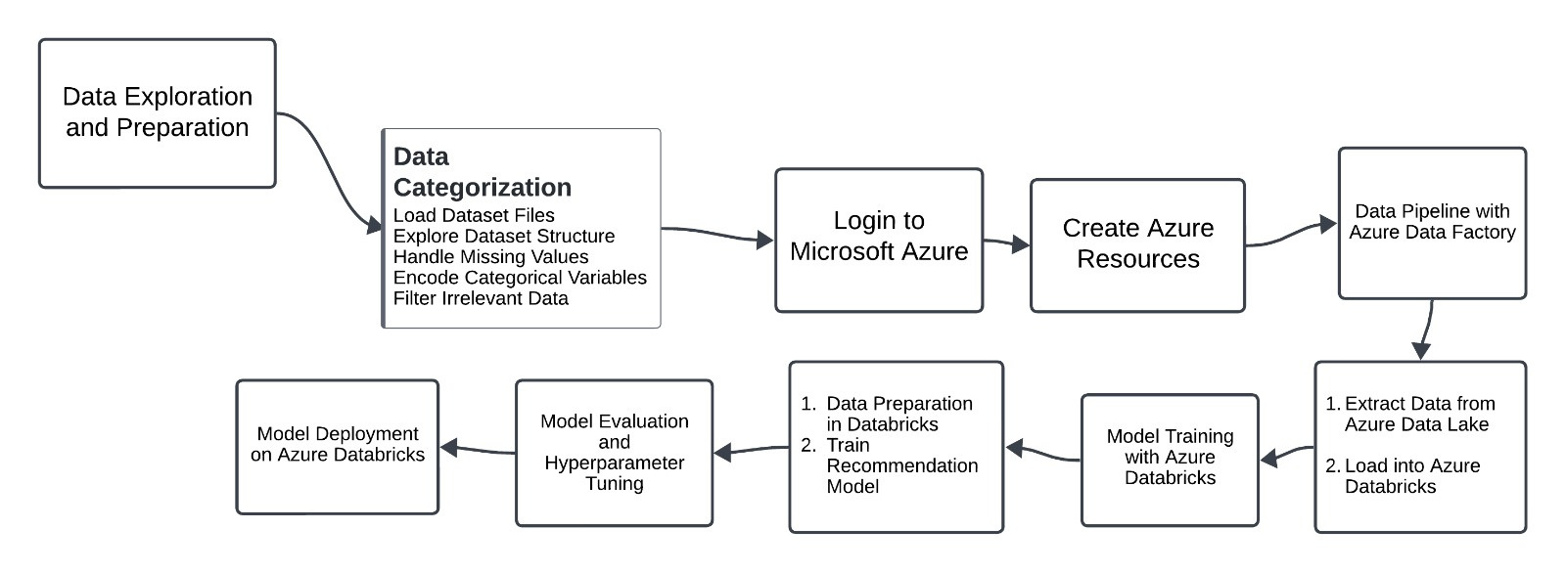


Flowchart

Slide 11

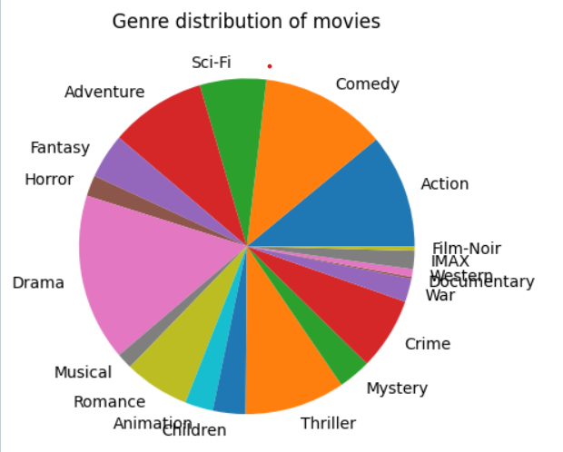
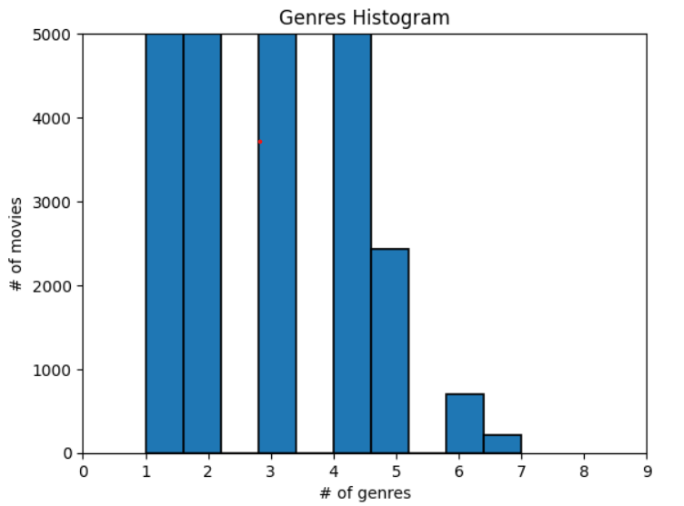
Results

Slide 12
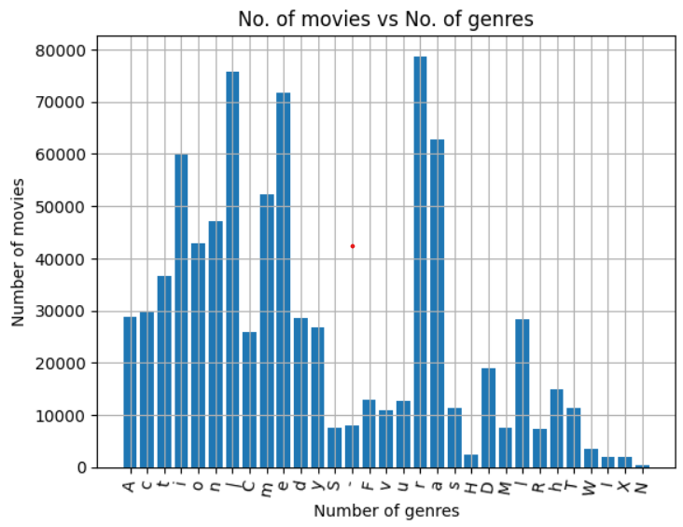
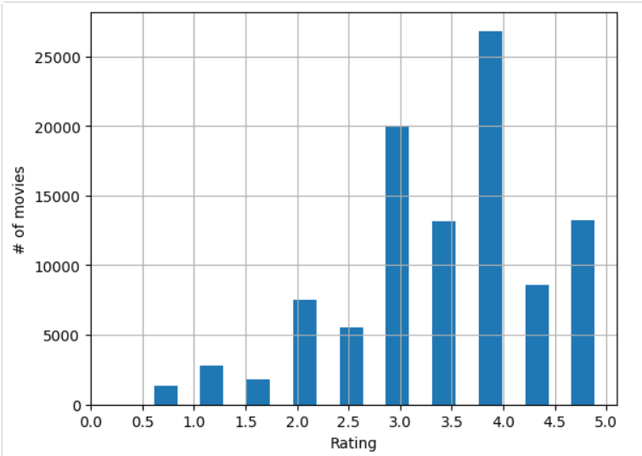
Results

Slide 13
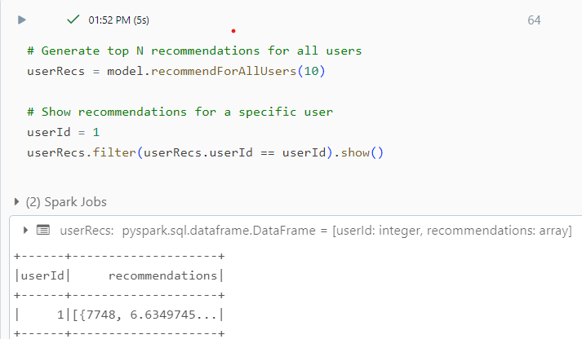
Results

Slide 14

Key Takeaways
Recommendation analysis using Spark SQL
Enables efficient data analysis and model building with distributed computing.
Simplifies data manipulation using familiar SQL syntax for querying and transformation.
Integrates seamlessly with Spark MLlib for recommendation model development.
Optimizes query performance with query planning and in-memory computation.
Supports real-time recommendations through structured streaming.
Ensures scalability and interoperability with various data sources for handling large datasets effectively.

